Slide 1
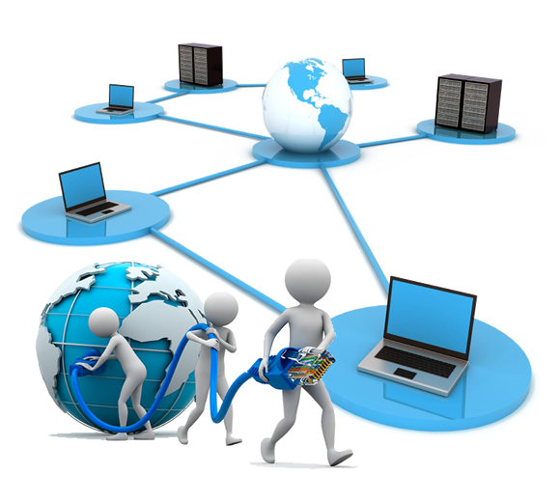
Introduction to Computer Network
Dr. Rania R Ziedan

Slide 2
Agenda
Introduction
Network types
Network topology
Network connection models
OSI model

Slide 3
Computer network
A collection of computing devices that are connected in various ways in order to communicate and share resources or files
Wired network: the connections between computers in a network are made using physical wires or cables
Wireless network: the connections between computers in a network are made using radio waves or infrared signals

Slide 4
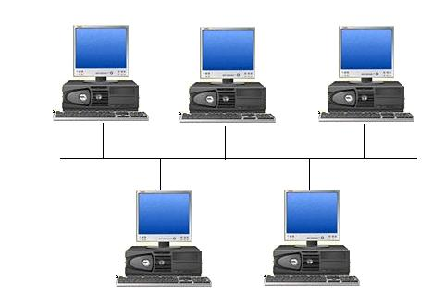
Computer network
Each computer in the network is known as: node or host
Data transfer rate: is the speed with which data is moved from one place on a network to another, which is a key feature in computer networks

Slide 5
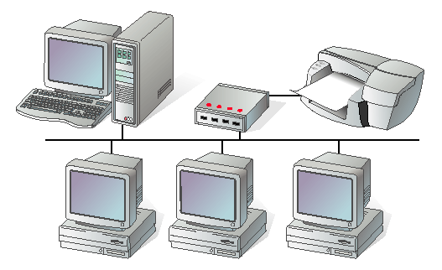
Network Types
Local Area Network (LAN): two or more computers connected together, the computers are physically near each other (for example: in the same building)
LANs are inexpensive to install
LANs provide higher speeds

Slide 6
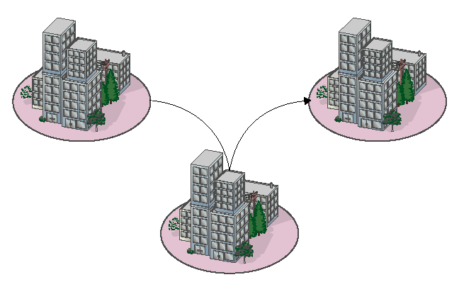
Network Types
Metropolitan Area Network (MAN): usually span tens of kilometers (for example: in the same city)
The cost of installation and operation is higher.
MANs use high-speed connections such as fiber optics to achieve higher speeds

Slide 7
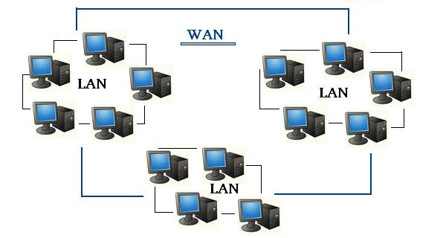
Network Types
Wide Area Network (WAN): is a connection of LANs (for example : the Internet)
WANs span a larger area than a single city.
These use long distance telecommunication networks for connection, thereby increasing the cost.

Slide 8
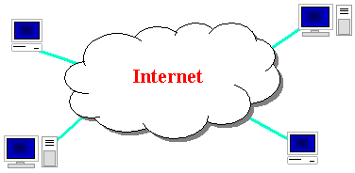
The Internet
It is a large group of computers that are connected to each other and used to send information quickly between computers around the world

Slide 9
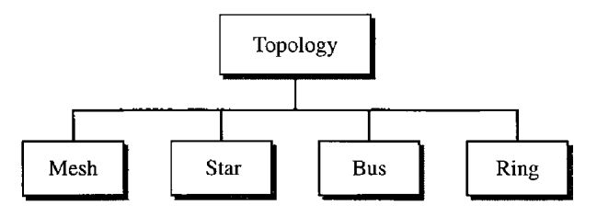
Physical topology of a network
The term physical topology refers to the way in which a network is laid out physically.
The topology of a network is the geometric representation of the relationship of all the links and linking devices
There are four basic topologies possible: mesh, star, bus, and ring

Slide 10
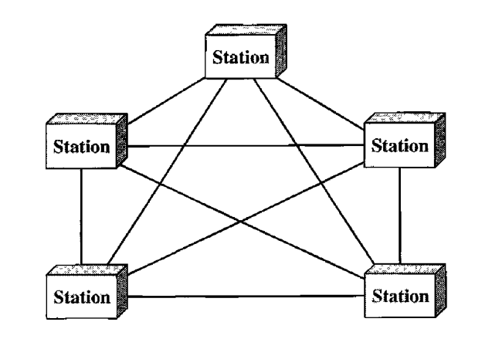
Physical topology of a network
Mesh Topology
In a mesh topology, every device has a dedicated point-to-point link to every other device.
The term dedicated means that the link carries traffic only between the two devices it connects.
The number of physical links in a fully connected mesh network with n nodes ➔ n(n-1)/2
The mesh topology used in the connection of telephone regional offices in which each regional office needs to be connected to every other regional office.

Slide 11
Physical topology of a network
Mesh Topology
Advantages:
Each link can carry its own data load, thus eliminating the traffic problems that can occur with shared links.
A mesh topology is robust. If one link becomes unusable, it does not incapacitate the entire system.
Every message travels along a dedicated line, only the intended recipient sees it. Physical boundaries prevent other users from gaining access to messages.
Point-to-point links make fault identification and fault isolation easy. Traffic can be routed to avoid links with suspected problems.
Disadvantage:
The amount of cabling and the number of I/O ports required.

Slide 12
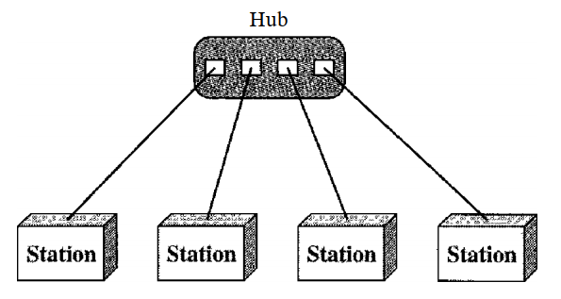
Physical topology of a network
Star Topology
Each device has a dedicated point-to-point link only to a central controller, usually called a hub.
A star topology does not allow direct traffic between devices.
The controller acts as an exchange: If one device wants to send data to another, it sends the data to the controller, which then relays the data to the other connected device.
The star topology is used in local-area networks (LANs)

Slide 13
Physical topology of a network
Star Topology
Advantages:
less expensive than a mesh topology, each device needs only one link and one I/O port to connect it to any number of others.
Easy to install and reconfigure.
Robustness, if one link fails, only that link is affected, all other links remain active.
As long as the hub is working, it can be used to monitor link problems and bypass defective links
Disadvantage:
the dependency of the whole topology on one single point, the hub. If the hub goes down, the whole system is dead

Slide 14
Physical topology of a network
Bus Topology
A bus topology is multipoint connection.
One long cable acts as a backbone to link all the devices in a network.
Nodes are connected to the bus cable by drop lines and taps.
There is a limit on the number of taps a bus can support and on the distance between those taps. As a signal travels along the backbone, some of its energy is transformed into heat. Therefore, it becomes weaker and weaker as it travels farther and farther.
Bus topology was the one of the first topologies used in the design of early local area networks.
The cable has two end terminals that dampen the signal so that it does not keep moving from one end of the network to the other.

Slide 15
Physical topology of a network
Bus Topology
Advantages:
Ease of installation
Bus uses less cabling than mesh or star topologies.
Disadvantages:
Difficult reconnection and fault isolation.
Difficult to add new devices.
Signal reflection at the taps can cause degradation in quality. This degradation can be controlled by limiting the number and spacing of devices connected to a given length of cable.
Adding new devices may therefore require modification or replacement of the backbone.
In addition, a fault or break in the bus cable stops all transmission, even between devices on the same side of the problem. The damaged area reflects signals back in the direction of origin, creating noise in both directions.

Slide 16
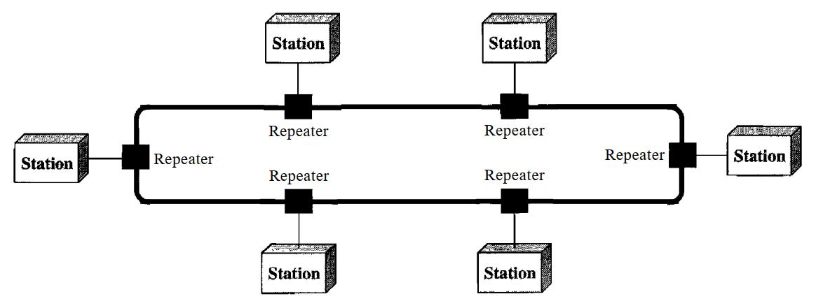
Physical topology of a network
Ring Topology
Each device has a dedicated point-to-point connection with only the two devices on either side of it.
A signal is passed along the ring in one direction, from device to device, until it reaches its destination.
Each device in the ring incorporates a repeater. When a device receives a signal intended for another device, its repeater regenerates the bits and passes them along

Slide 17
Physical topology of a network
Ring Topology
Advantages:
easy to install and reconfigure
Fault isolation is simplified.
Generally in a ring, a signal is always circulating . If one device does not receive a signal within a specified period, it can issue an alarm. The alarm alerts the network operator to the problem and its location.
To add or delete a device requires changing only two connections. The only constraints are media and traffic considerations (maximum ring length and number of devices).
Disadvantages:
Unidirectional traffic
a break in the ring can disable the entire network.
This weakness can be solved by using a dual ring or a switch capable of closing off the break.

Slide 18
Network connection models
Networks can also be classified according to the roles that the networked computers play in the network’s operation.
Peer-to-peer,
server-based,
and client-based.

Slide 19
Network connection models
Peer-to-peer model all computers are considered equal. Each computer controls its own information and is capable of functioning as either a client or a server depending upon the requirement.
Peer-to-peer networks are inexpensive and easy to install.
They are popular as home networks and for use in small companies.
Most operating systems come with built-in peer-to-peer networking capability.
The maximum number of peers that can operate on a peer-to-peer network is ten.
Each peer shares resources and allows others open access to them.
Shares can be document folders, printers, peripherals, and any other resource that they control on their computers.

Slide 20
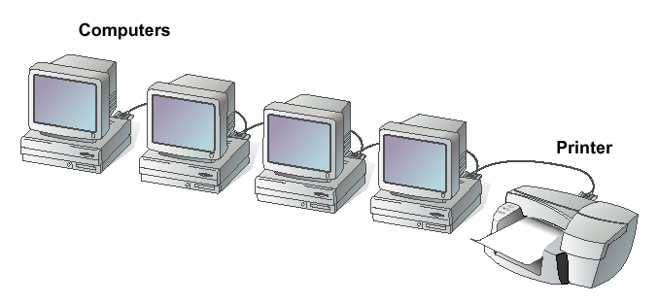
Network connection models
Peer-to-peer network

Slide 21
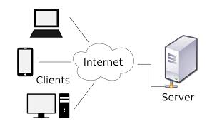
Network connection models
client-server model is a software that consists of two parts, client systems and server systems, both communicate over a computer network

Slide 22
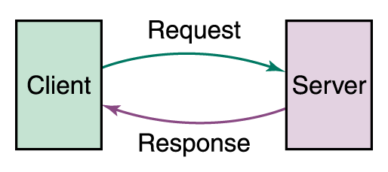
Network connection models
The client-server relationship describes the relation between the client and how it makes a service request to the server, and how the server can accept these requests, process them, and return the requested information to the client

Slide 23
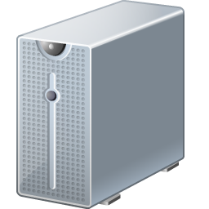
How the Web Works?
WWW use classical client / server architecture
HTTP is text-based request-response protocol
HTTP
Page request
HTTP
Server response
Server running Web Server Software (IIS, Apache, etc.)
Client running a Web Browser

Slide 24
Client/Server
There are two types of servers:
File server A computer that stores and manages files for multiple users on a network
Web server A computer that responds to requests for web pages (from the browser client)

Slide 25
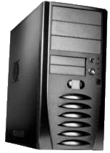
Web servers and browsers
web server: software that listens for web page requests
Apache
Microsoft Internet Information Server (IIS) (part of Windows)
web browser: fetches/displays documents from web servers
Mozilla Firefox
Microsoft Internet Explorer (IE)
Apple Safari
Google Chrome
Opera

Slide 26
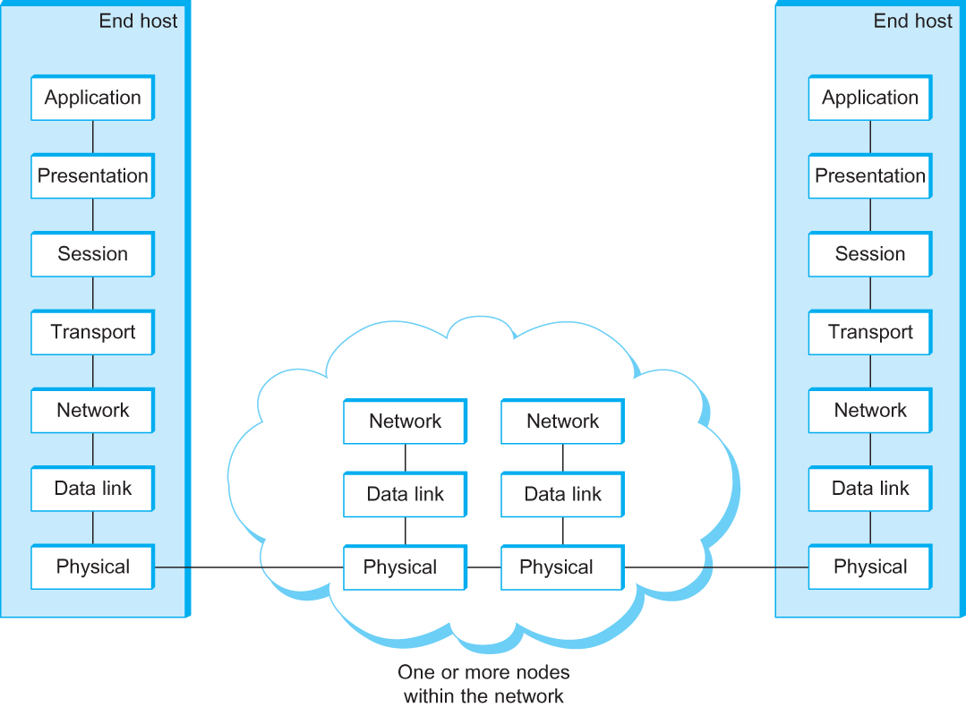
OSI Architecture
The OSI 7-layer Model
OSI – Open Systems Interconnection

Slide 27
Description of Layers
Physical Layer
Handles the transmission of raw bits over a communication link
Data Link Layer
Collects a stream of bits into a larger aggregate called a frame
Network adaptor and device drivers in OS implement the protocol in the datalink layer
Frames are actually delivered to hosts
Network Layer
Handles routing between nodes within a packet-switched network
Unit of data exchanged between nodes in this layer is called a packet
The lower three layers are implemented on all network nodes

Slide 28
Description of Layers
Transport Layer
Implements a process-to-process channel
Unit of data exchanges in this layer is called a message
Session Layer
Provides a name space that is used to tie together the potentially different transport streams that are part of a single application
Presentation Layer
Concerned about the format of data exchanged between peers
Application Layer
Standardize common type of exchanges
The transport layer and the higher layers typically run only on end-hosts and not on the intermediate switches and routers

Slide 29
Summary
A computer network consists of two or more computers that are connected and are able to communicate.
The basic purpose of networks is to enable effective communication, share resources, and facilitate centralized management of data.
Networks can be classified according to their geographical boundaries or their component roles.
The topology of a network is the geometric representation of the relationship of all the links and linking devices

Slide 30
Questions???

